Slide 1
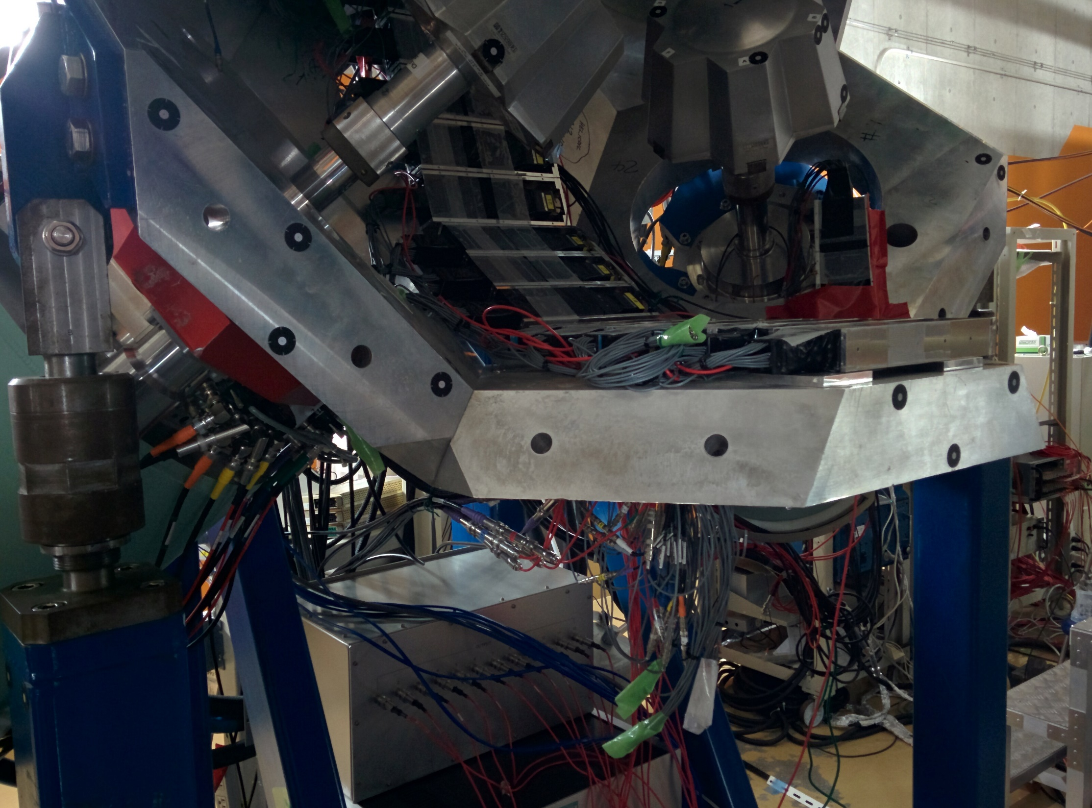
Support to centre of EURIKA ~60cm

Slide 2
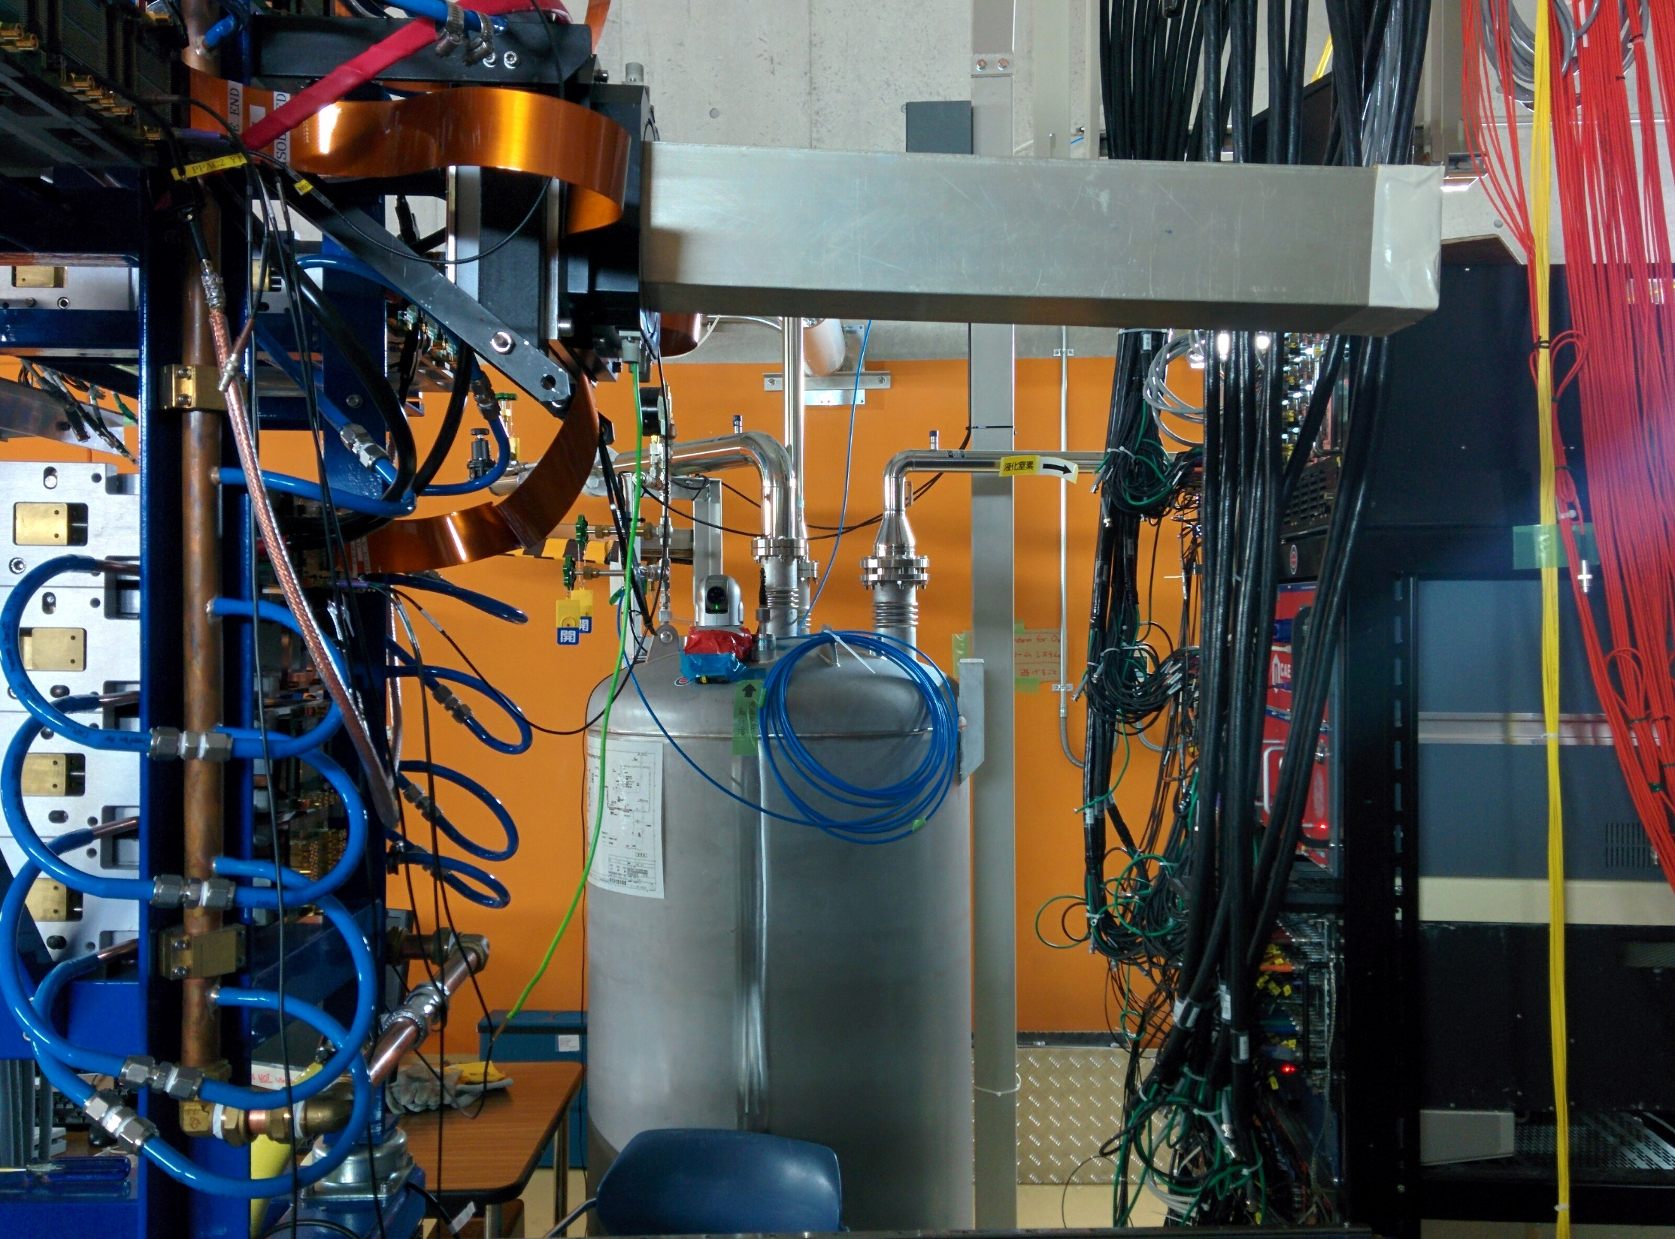
Cu cooling pipe to end of snout ~75cm
End of snout to base ~ 57cm

Slide 3
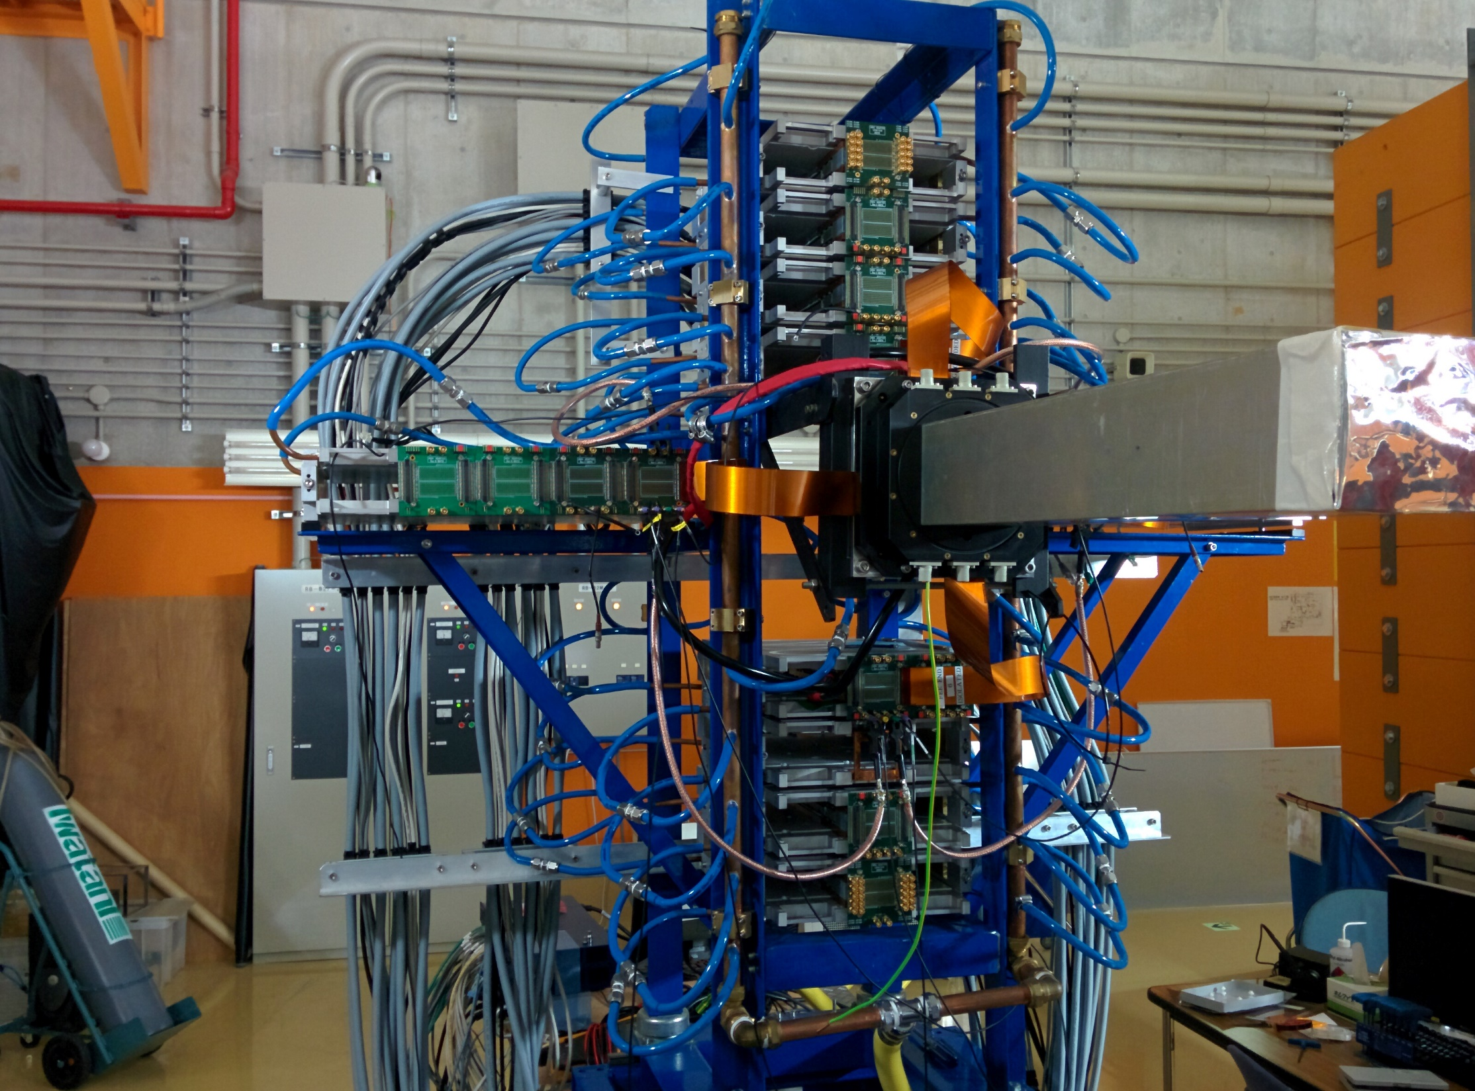
For horizontal FEEs:
Min distance from end of snout to inner most FEE ~ 92cm
Additional 6cm per extra FEE outwards

Slide 4
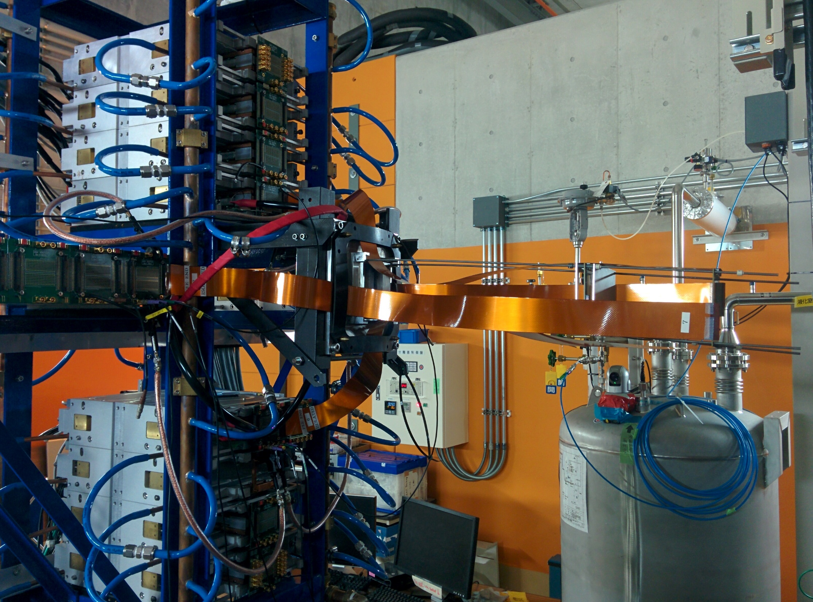
Furthest a DSSSD can go from the base of the snout ~ 54cm (~ 60cm from main Cu pipe).
Limiting factor is kaptons to nnaida5+6 (top of bottom stack). A few more cm can be achieved with other FEEs.

Slide 5
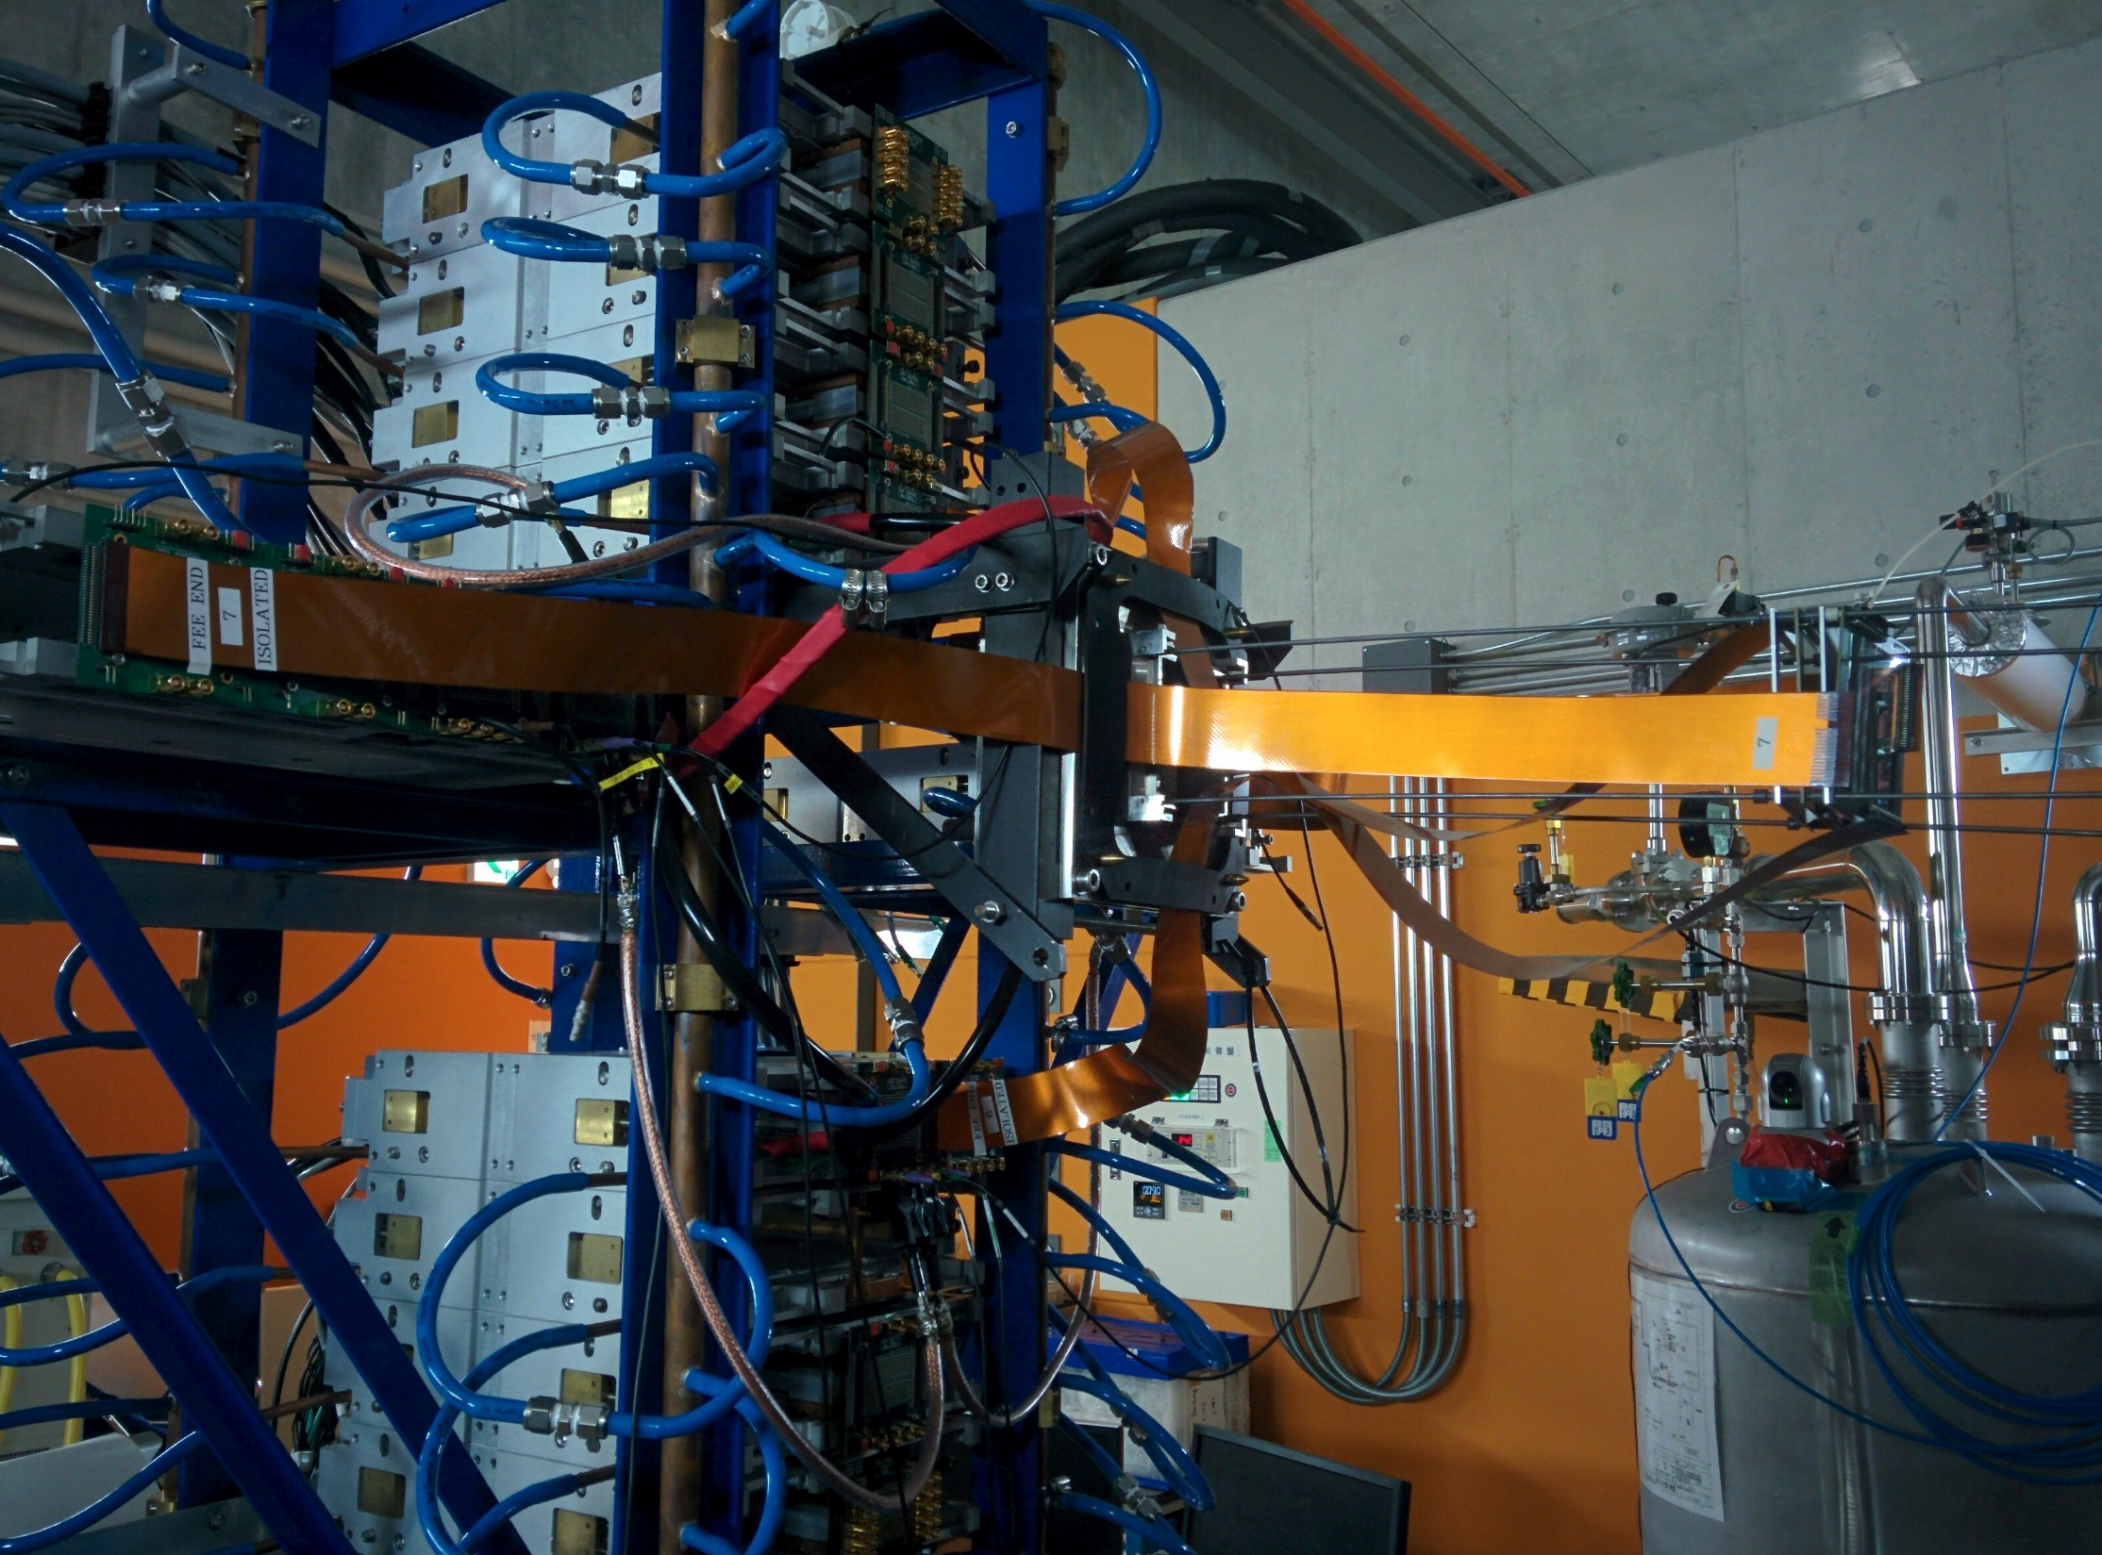
Distance from DSSSD to base of snout
- with kapton in 4th connector along: ~ 48cm
- with kapton in 8th connector along: ~ 36cm
4th position
8th position

