Slide 1

Summary of AIDA Tests
2022-3
Tom Davinson
School of Physics & Astronomy
U
N
I
V
E
R
E
S
I
H
T
T
Y
O
H
F
R
G
E
D
I
B
U
N

Slide 2
Background
The 2022 campaign highlighted some AIDA issues – in particular
24cm x 8cm ‘triple’ AIDA DSSSD
strip lengths – p+n side 7.5cm, n+n side 22.5cm
n+n Ohmic strip noise higher than expected & unstable
Subsequent detailed, systematic tests at GSI ( S4 & CRYRING ), STFC DL, CERN ( n_TOF/EAR2 & HIE-ISOLDE ) of all AIDA system components and DESPEC ac mains power during 2022/3 identified issues with
pulser
sum & invert amplifier
detector bias
AC coupling

Slide 3
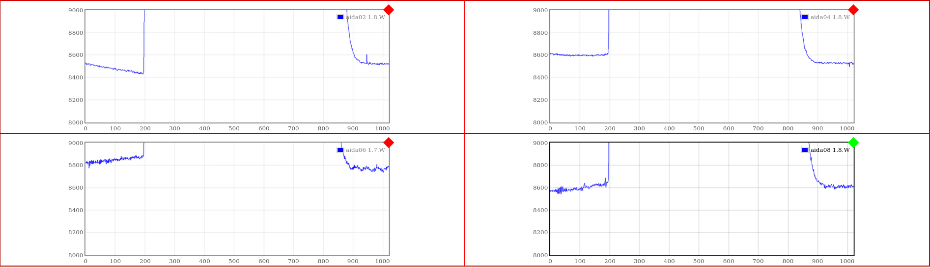
New AIDA adaptor PCB
AIDA adaptor PCB
connects AIDA front end electronics (FEE64) to DSSSD
provides AC coupling for ASIC
provides connections for test and detector bias
OLD rev A 120418 design improvements identified by tests
NEW rev B specification completed March 2023
rev B 120623 PCBs available for tests July 2023
pulser signal
NEW
NEW
OLD
OLD
Per strip preamplifier outputs – no cabling or DSSSD – y-axis = 122mV, x-axis = 20μs

Slide 4
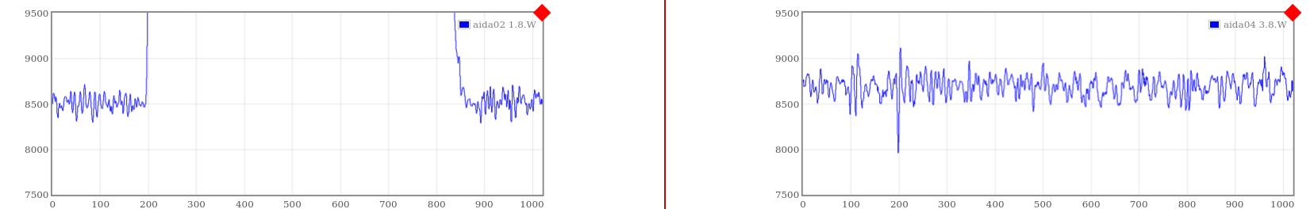
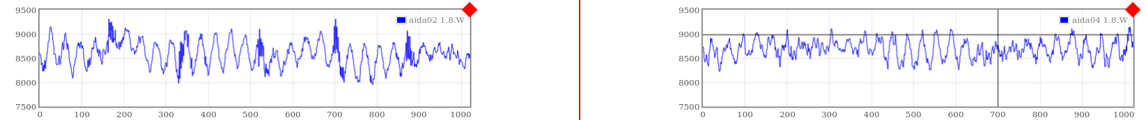
24cm x 8cm ‘triple’ DSSSD – n+n Ohmic strips
NEW
Oct 2023
OLD
May 2022
Per strip preamplifier outputs – y-axis range = 244mV, x-axis range = 20μs

Slide 5
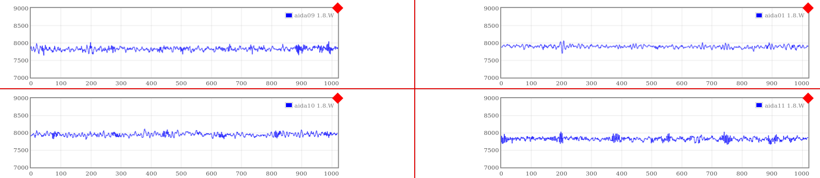
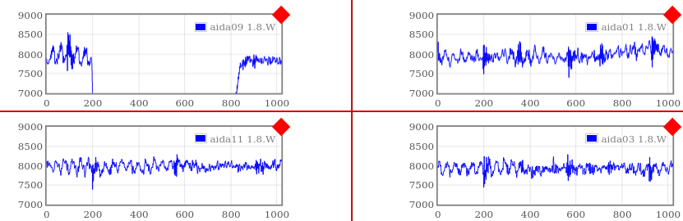
24cm x 8cm ‘triple’ DSSSD – p+n junction strips
NEW
Oct 2023
OLD
May 2022
Per strip preamplifier outputs – y-axis range = 244mV, x-axis range = 20μs

Slide 6
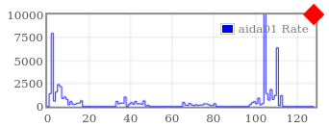
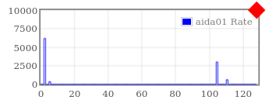
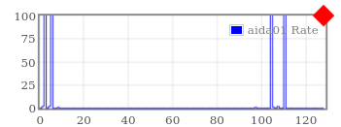
24cm x 8cm ‘triple’ DSSSD – p+n junction strips
OLD
May 2022
NEW
Oct 2023
Rate/ASIC channel (Hz)
NEW
Oct 2023
x100 change in y-scale
FEE64 aida01 rate/channel ( Hz ) – 100keV threshold
Further tests with thresholds 50-90keV confirm 5σ threshold c. 90-100keV
Most channels ( ~ 60-62 of 64 ) < 1Hz
2-4 ‘hot’ channels per FEE64 at physical boundaries of FEE64
– ‘hot’ channels less hot

Slide 7
Summary
Typical electronic noise ( keV FWHM ) 24cm x 8cm ‘triple’ DSSSD
OLD May 2022
p+n junction strip ~ 90
n+n Ohmic strip ~ 300
NEW Oct 2023
p+n junction strip ~ 45
n+n Ohmic strip ~ 75
New values consistent with calculated noise for ‘triple’ DSSSD input
load ( capacitance and leakage current ). Will continue to optimise.
Noise of ‘hot’ channels ~ 70-80 keV FWHM
Further information see
  https:/elog.ph.ed.ac.uk/DESPEC/522
  https://elog.ph.ed.ac.uk/AIDA/907

Slide 8
Thanks
Many thanks to
Edinburgh - Oscar Hall, Richard Taylor
GSI – Helena Albers, Jeroen Bormans, Carole Chatel, Nic Hubbard

Slide 9
Postscript – December 2023
AIDA noise stable with respect to multiple mechanical assembly cycles
improvements are robust
AIDA noise stable with respect to installation and operation of bPlas
AIDA and bPlas interoperable

