Slide 1
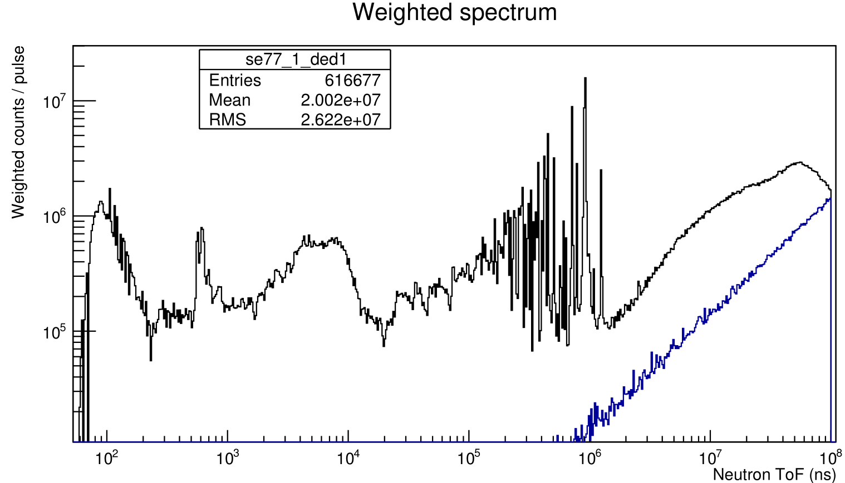
Se77: Ambient BG and Raw Data
Dedicated, C6D6 1
Normalized in bunches to data

Slide 2
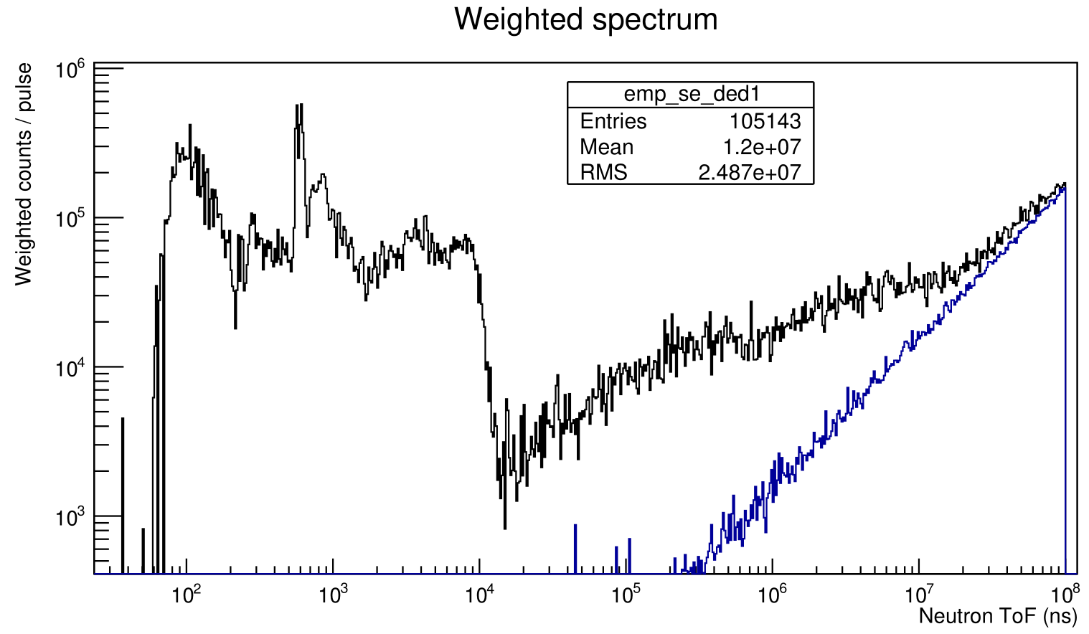
Se77: Ambient BG and Empty Holder
Dedicated, C6D61
Normalized in bunches to empty

Slide 3
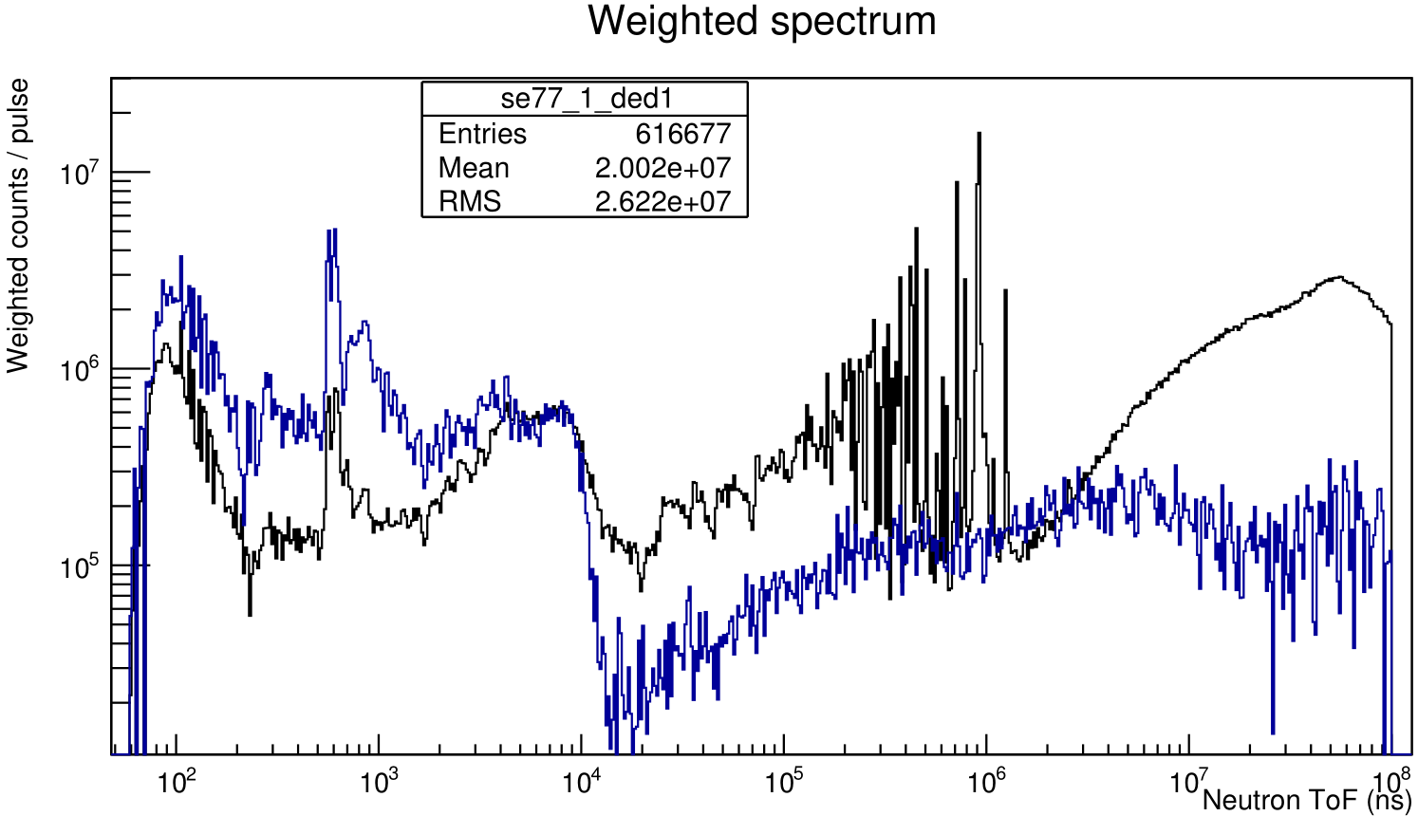
Se77: Raw Data and Empty Holder
Dedicated, C6D6 1
Normalized in protons to raw data
Over-subtraction

Slide 4
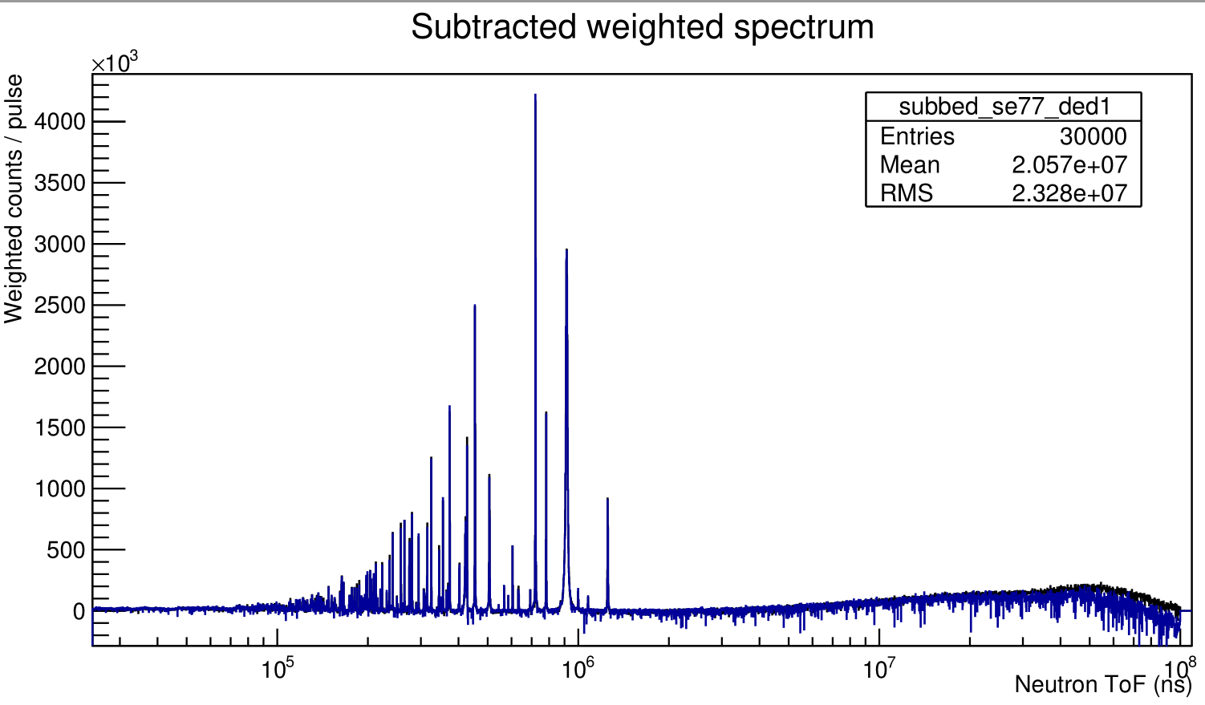
Subtracted Se77 Spectra
C6D6 1, normalized in protons to dedicated
Disagreement (missing scaling factor?)
Dedicated Parasitic
Over-subtraction

Slide 5
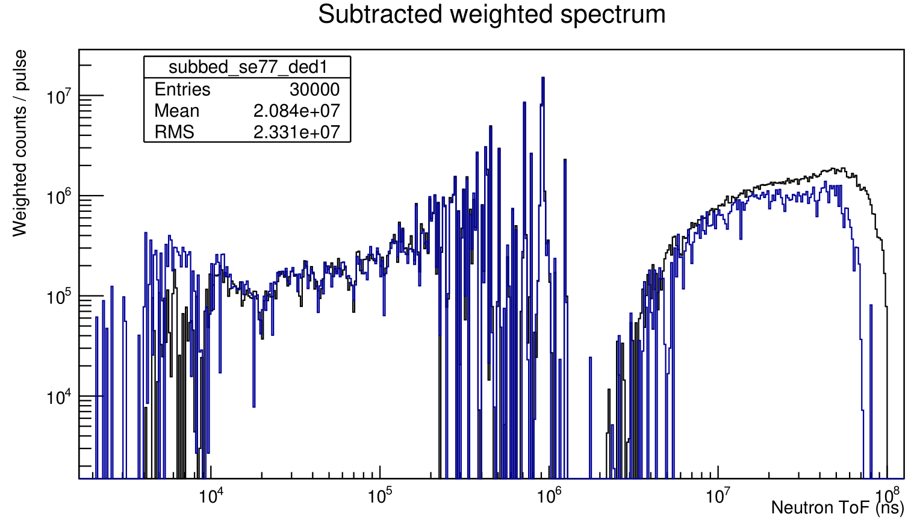
Subtracted Se77 Spectra
C6D6 1, normalized in protons to dedicated
Beam profile?
Dedicated Parasitic

Slide 6
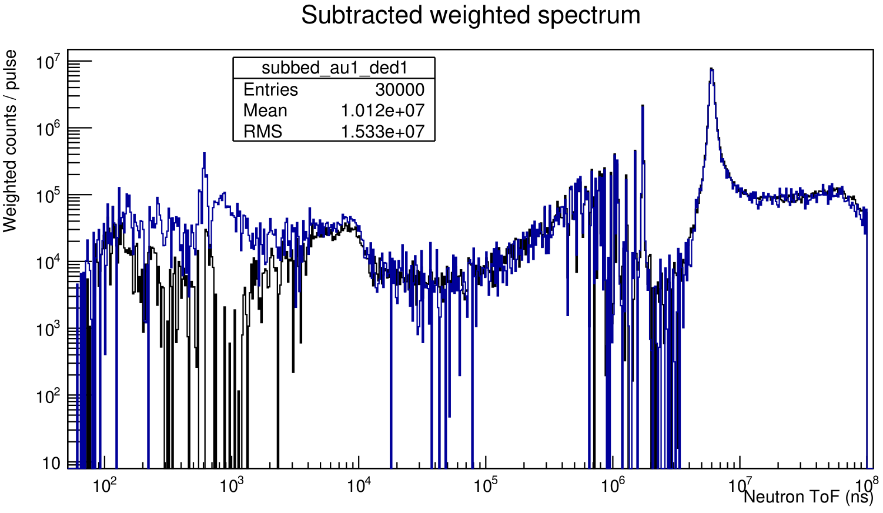
Subtracted Au197 Spectra
C6D6 1, normalized in protons to dedicated
Dedicated Parasitic

Slide 7
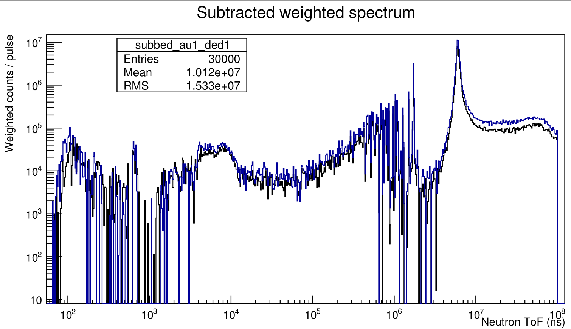
Subtracted Au197 Spectra
C6D6 1, no normalization
Calibration 1 Calibration 2

Slide 8
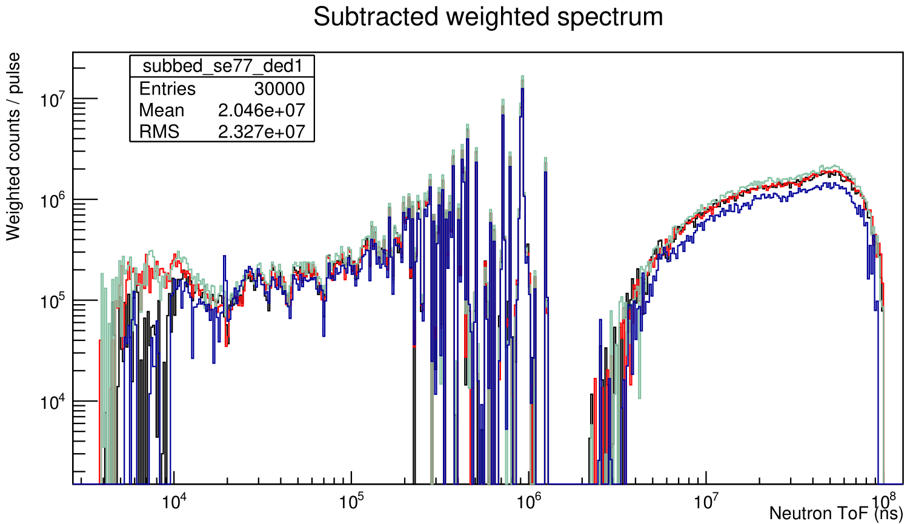
Se77 All Scintillators
No normalization
C6D6 1
C6D6 2
C6D6 3
C6D6 4

Slide 9
Quickly fit Gaussian to 4.906 eV resonance to get approx. ToF
L ≈ 184.97 +/- 0.10 m
No sqrt(N) in uncertainty, since otherwise it’s unrealistically small and the shape is not Gaussian anyway
Improve with Breit-Wigner?
Not produced sum spectra yet (should it be an average of all C6D6s?)

