Slide 1
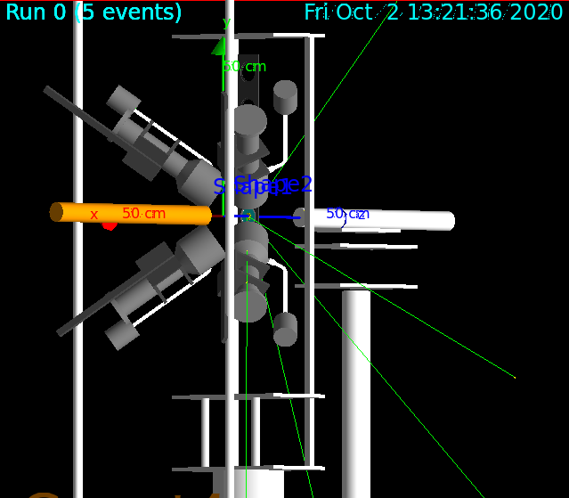
Detector Calibration
C6D6 gamma detectors
Low Z -> Compton effect
Hard to calibrate
Calibrate using Compton edges
Need calculation of Compton edge positions
GEANT4
Ran for ^{77,78}Se, Gold and ⁶⁸Zn targets

Slide 2
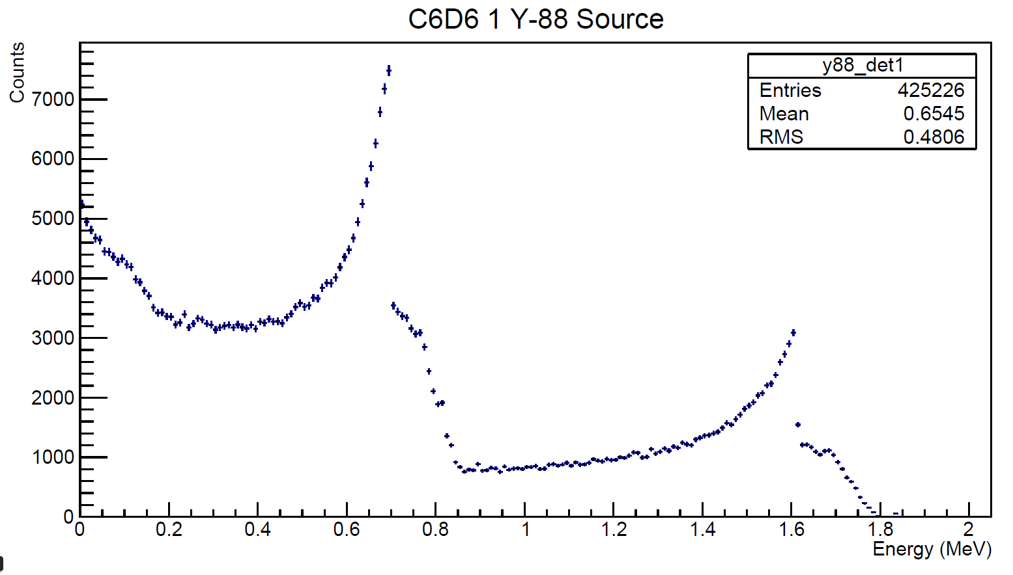
Detector Calibration
GEANT4 does not include detector resolution (broadening)
Calibrate position of Compton edges and experimental broadening iteratively
Use experimental data, compare to GEANT4
Re-broaden and re-calibrate GEANT4 results, compare again

Slide 3
Detector Calibration
Used ¹³⁷Cs, ⁸⁸Y, AmBe, CmC sources
Calibrate by fitting Gaussian to high-E tail, get mean $μ$ and std.dev. $σ$
Matching point defined as $y=μ+σ\sqrt{2ln2}$

Slide 4
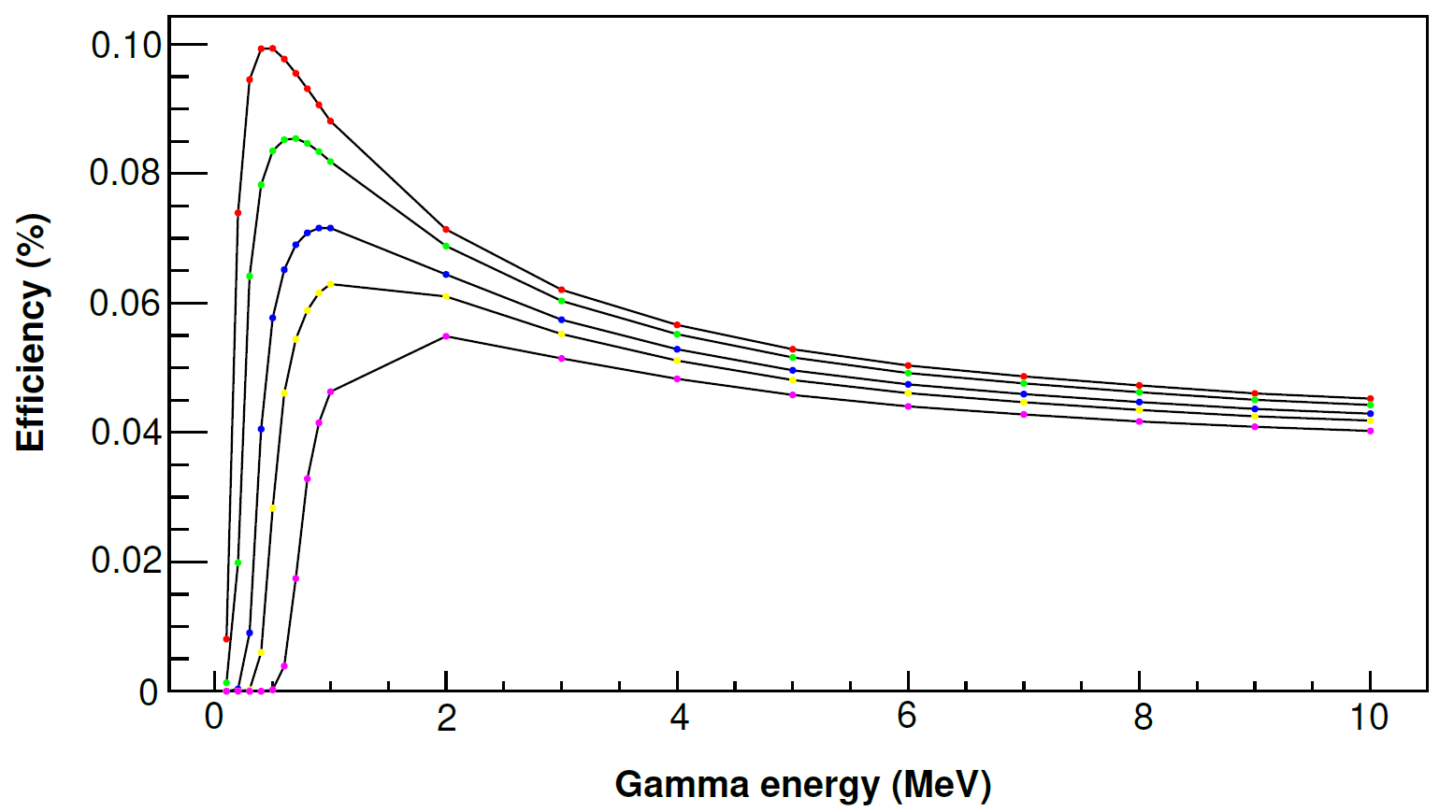
Detector Calibration
To obtain cross-sections, need to count gammas from (n,γ) reaction
Detector efficiency not the same for different gamma energies
Use weighting functions to “linearize” detector response, restore counting proportionality
Calculated using code by F. Gunsing
Colours correspond to different thresholds

Slide 5
Detector Calibration
Produce weighting functions for each simulated target
WFs for individual detectors or for summed response energy spectra
200 keV threshold added
Sum WF
Sum WF
Residuals
(a bit better)
Individual WF
residuals

Slide 6
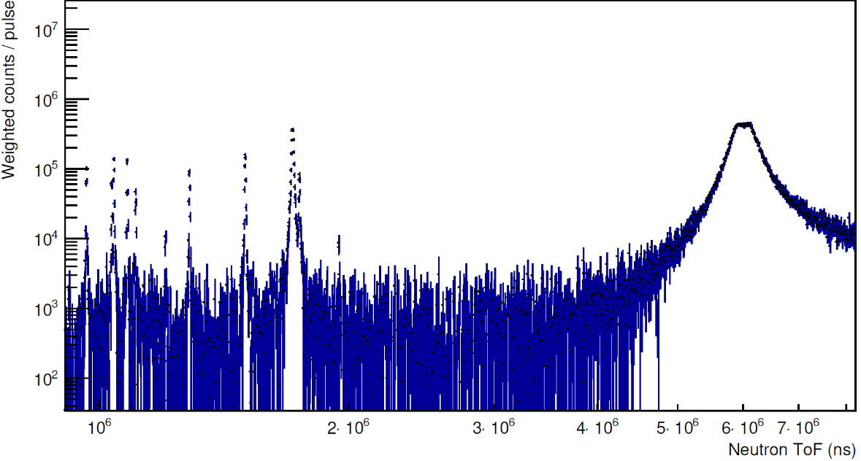
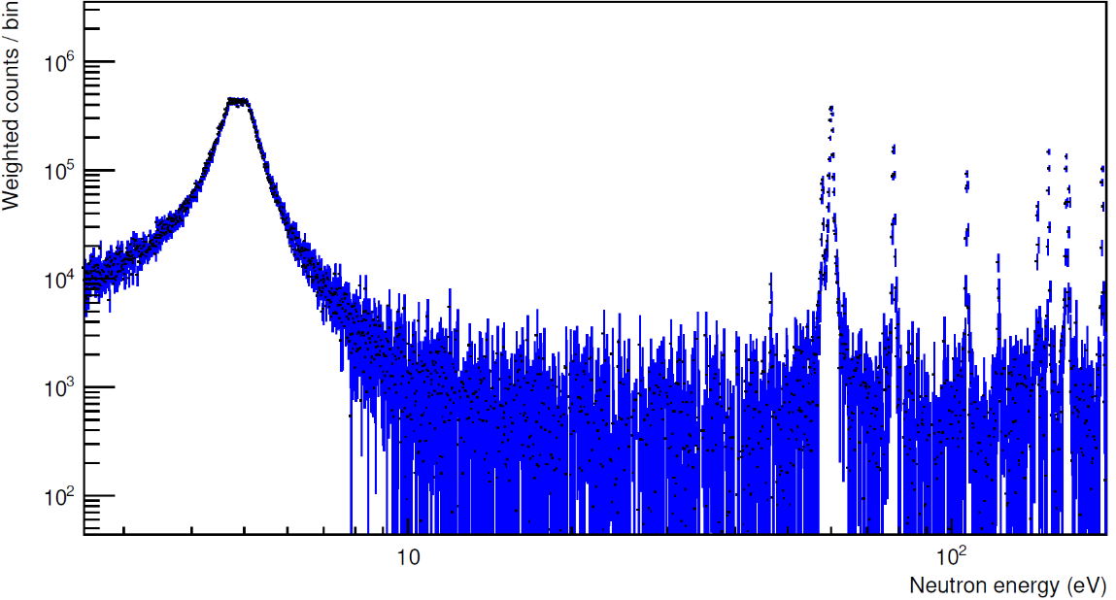
Time-of-Flight method
Neutron energy determined from precise knowledge of time-of-flight and flightpath
Flightpath calibrated using well-known resonance in ¹⁹⁷Au
For sub-MeV neutrons $E_{n}=\frac{mv^{2}}{2}={(α\frac{L}{t})}^{2}$
Iterative calibration
Assume an approximate flightpath L, calibrate gold resonances, fit resonances using SAMMY, compare to known, change L
¹⁹⁷Au

Slide 7
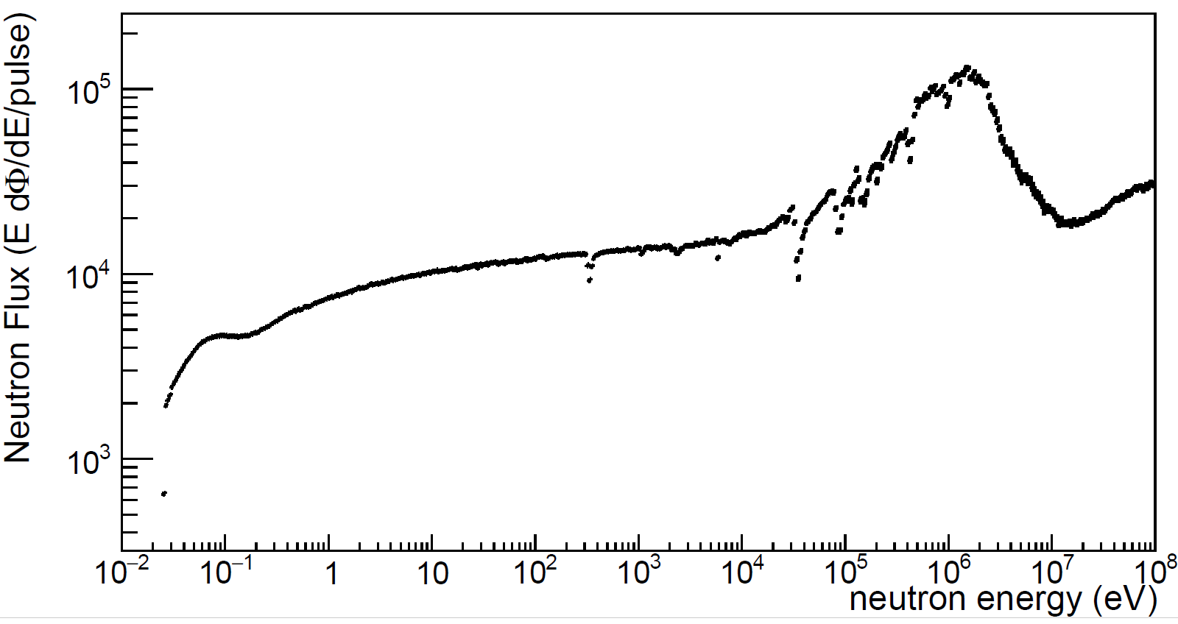
Yield Determination
Convert weighted counts spectra to yield
Normalize by the neutron flux
Normalize by excitation energy of compound system ($E^{∗}=E_{n}+S_{n}$)

Slide 8
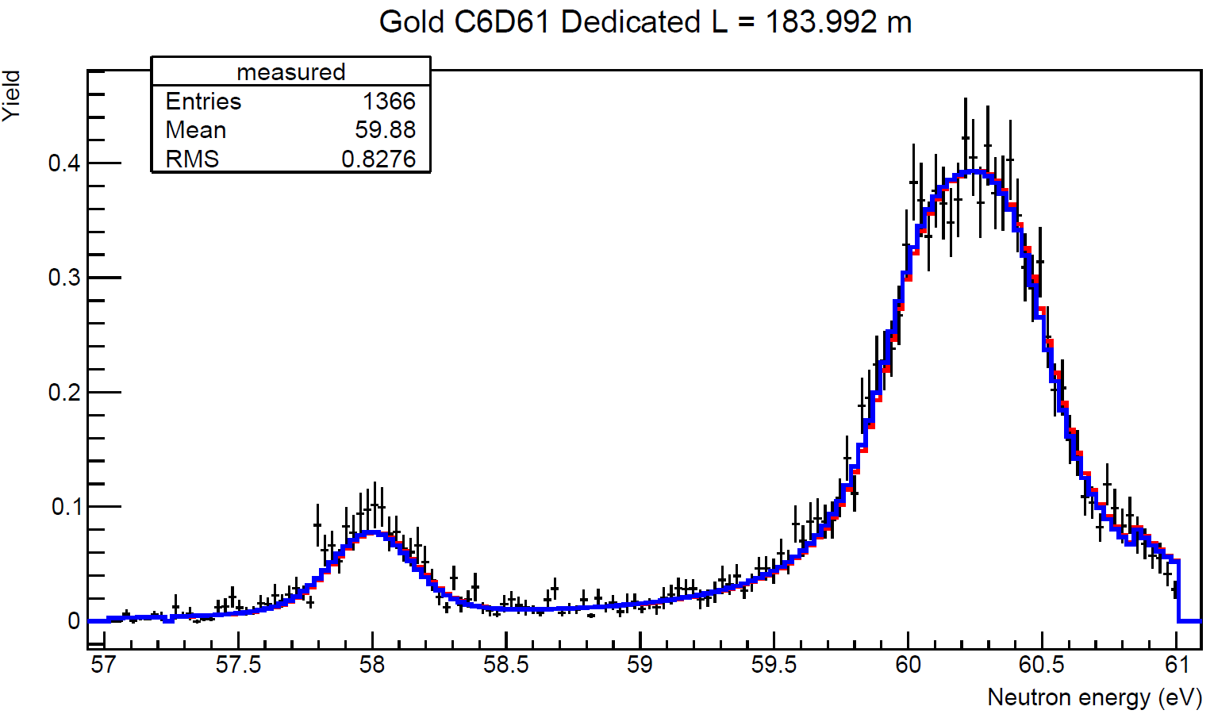
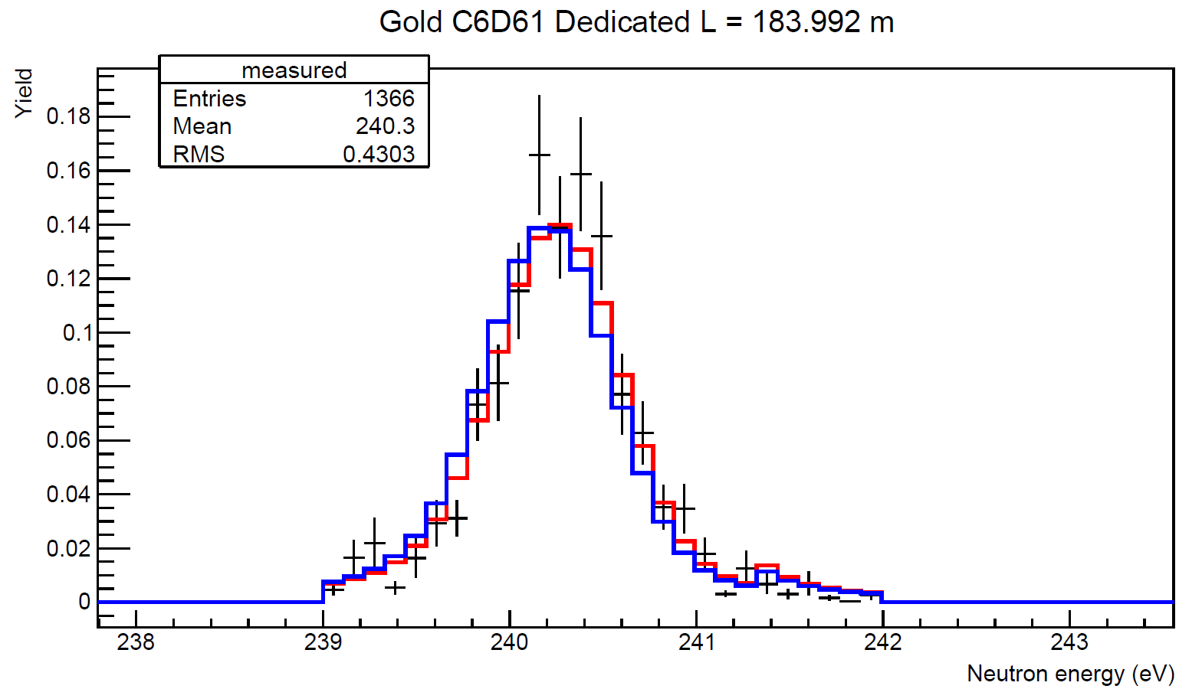
SAMMY Fits to Gold
SAMMY fits to yield spectra
Comparison data from ENDF/B-VIII.0 release
Initial fit
Final fit
Initial fit
Final fit

Slide 9
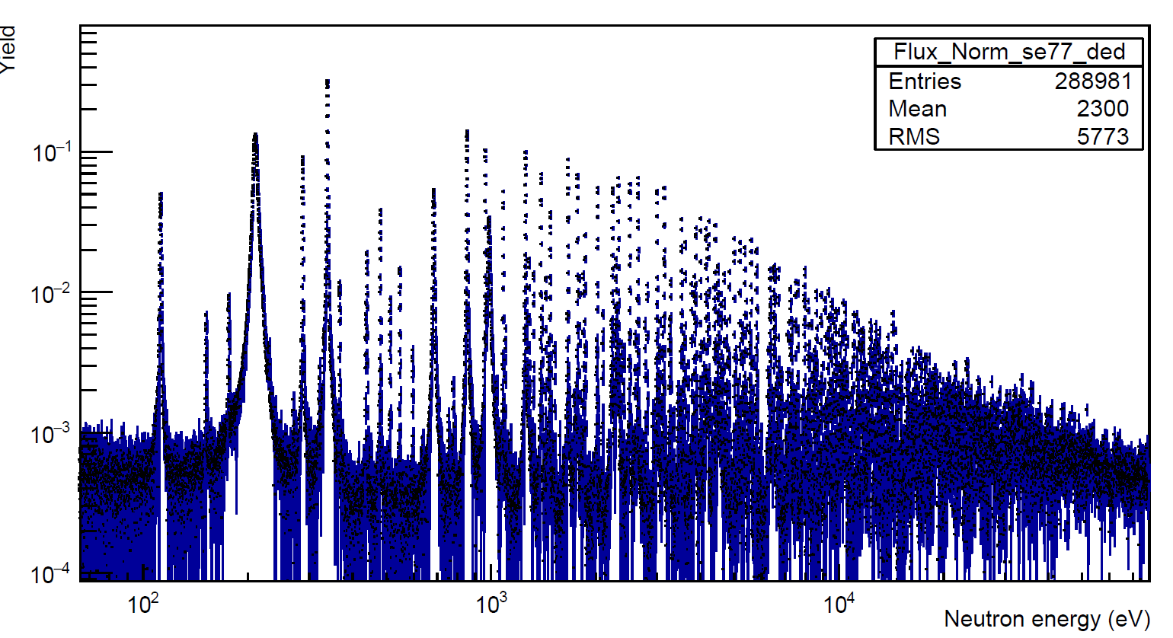
Se-77 Resonance Identification
Comparison data from ENDF/B-VIII.0 release for ⁷⁷Se + other isotopes in target (99.66% purity)
Fit all the resonances in the yield spectra
Verify previously-known resonances (37), identify new ones
Ongoing
Se-77 Resonances

Slide 10
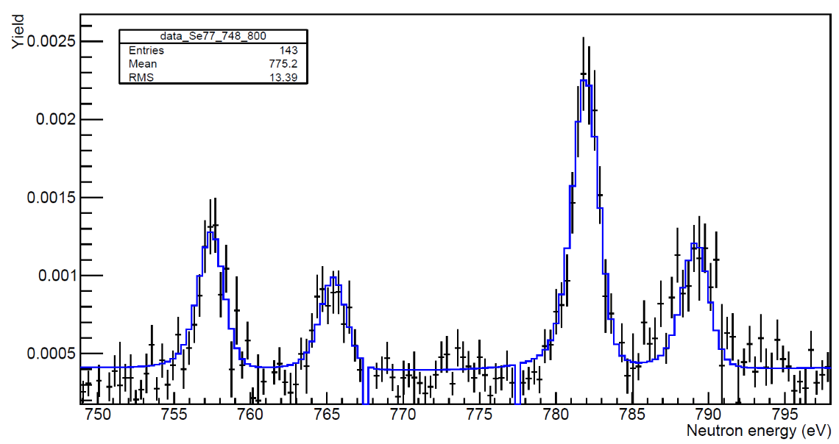
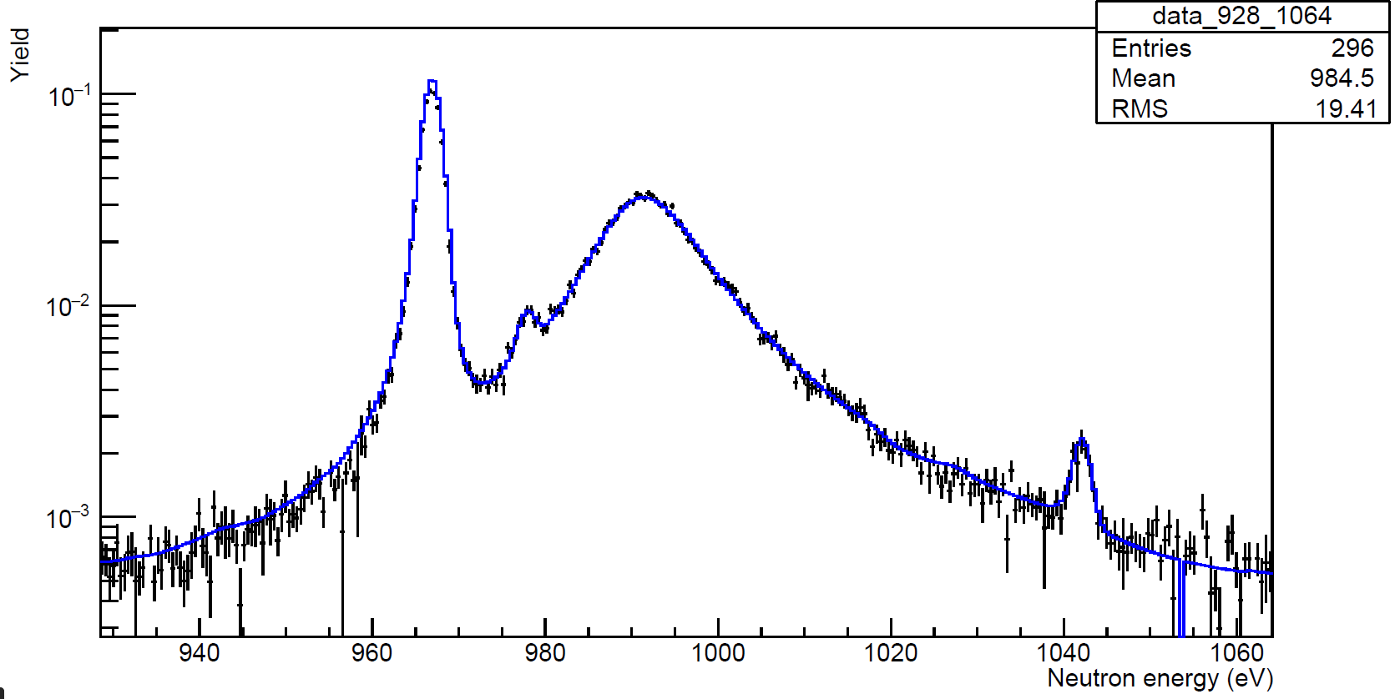
Se-77 Resonance Identification
Data checked between 100 eV and 2 keV
14 suspected new resonances so far
New resonances
New small resonances

