Slide 1
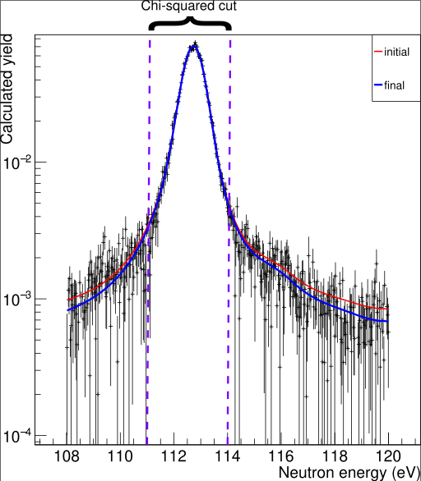
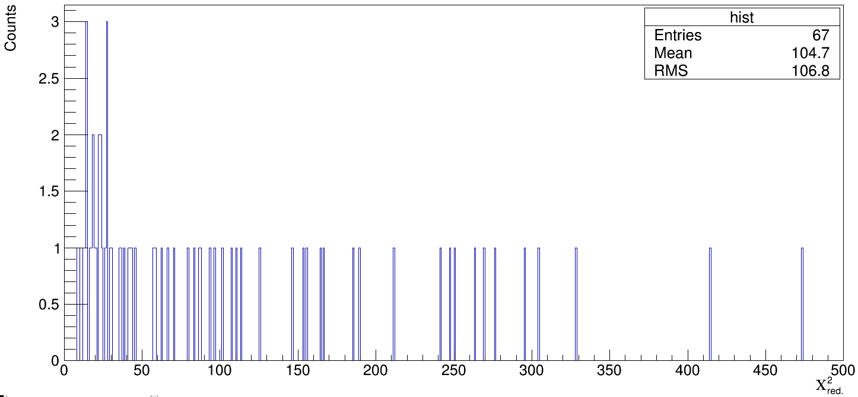
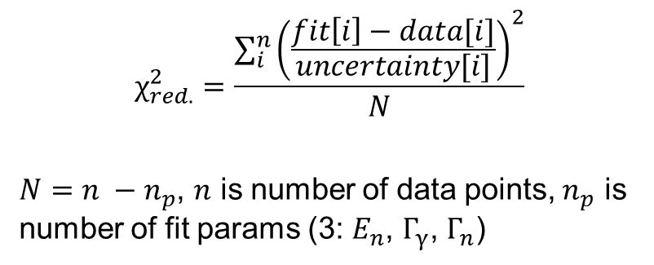
Fitting
$$χ_{red.}^{2}=\frac{\sum_{i}^{n}{{\left(\frac{fit\left[i\right]−data[i]}{uncertainty[i]}\right)}^{2}}}{N}$$
$N=n −n_{p}$, $n$ is number of data points, $n_{p}$ is number of fit params (3: $E_{n}$, $Γ_{γ}$, $Γ_{n}$)

Slide 2
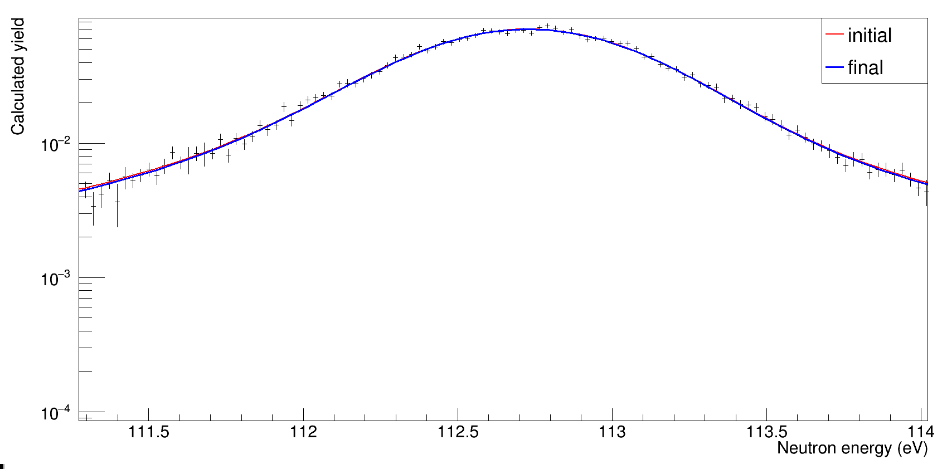
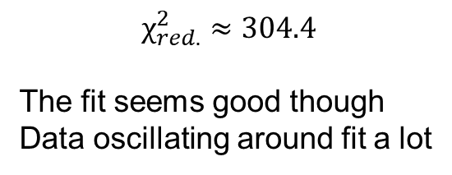
Fitting
$$χ_{red.}^{2}≈304.4$$
The fit seems good though
Data oscillating around fit a lot

Slide 3
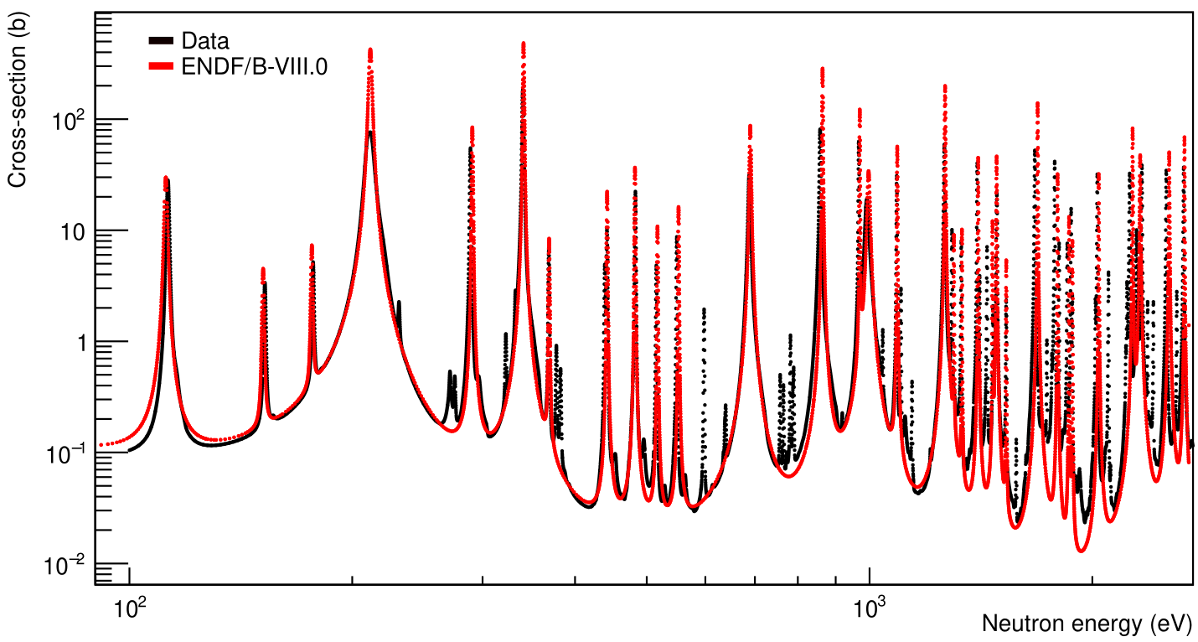
Cross-Section SAMMY v ENDF8
SAMMY: Normalize as cross section rather than yield, no Bayes, no fitting

Slide 4
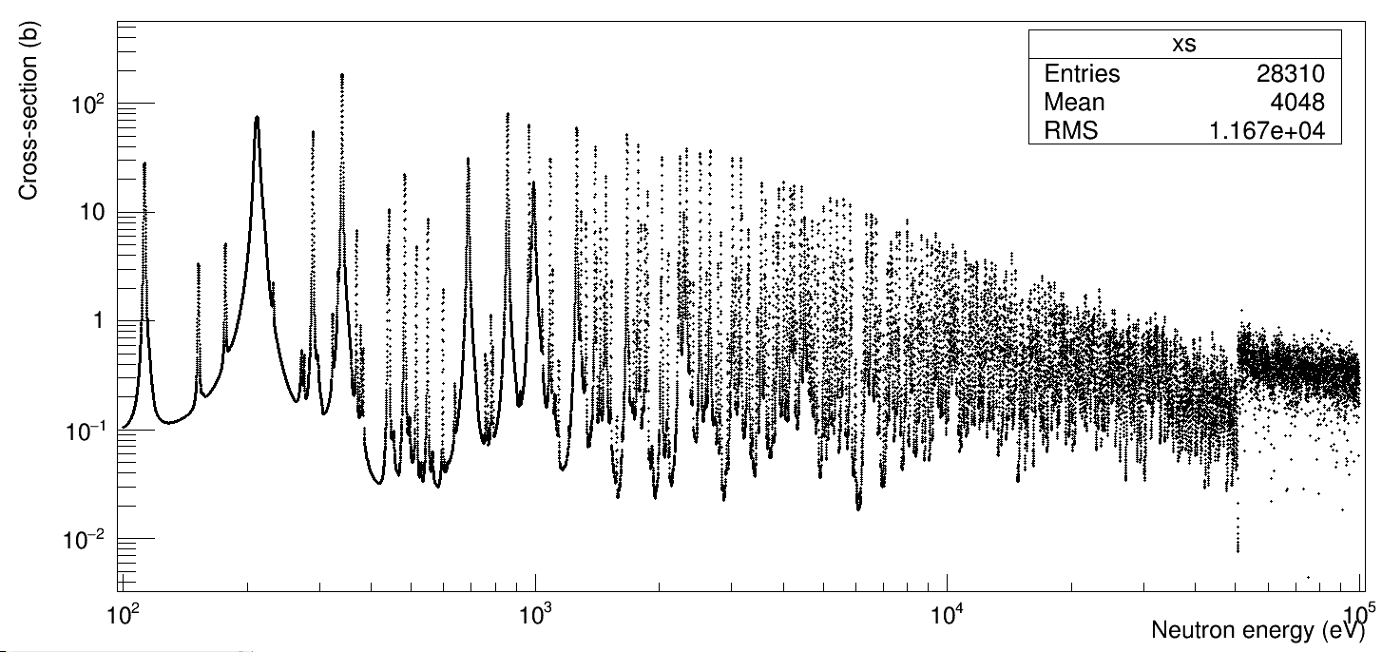
MACS
Data don’t match
used a fudge factor = 1.387
Factor from comparing resolved calc to SAMMY
$$XS= \frac{Data}{Normalization ∗Areal_density}$$
Resolved XS from SAMMY, some other factors?
Unresolved

Slide 5
MACS
At T = 30 keV, 100 eV – 100 keV MACS = 242 mb
KADoNiS = 418±71 mb
Rene’s corrections: JEFF ok? Or send ENDF?

Slide 6
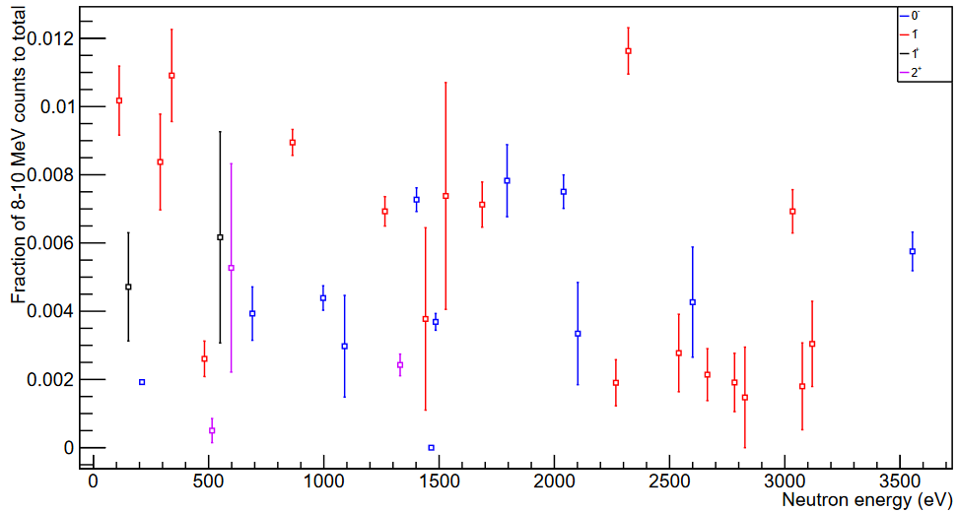
High-energy Gammas

Slide 7
High-energy Gammas
Changing spin group in SAMMY makes Γγ a lot worse (can’t swap with Γn, also v. bad)

