Slide 1
^{n_TOF Data}
α/p/t/γ…
Detector
Source
Nikolay Sosnin ²⁶Al Filtering 31 July 2023

Slide 2
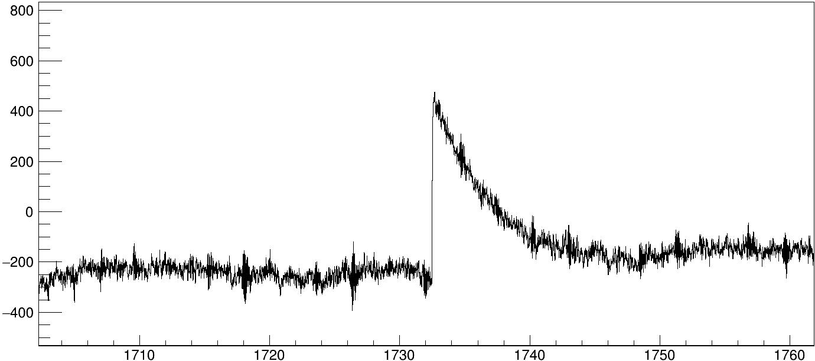
^{n_TOF Data}
α/p/t/γ…
Detector
Source
Voltage
Time
Nikolay Sosnin ²⁶Al Filtering 31 July 2023

Slide 3
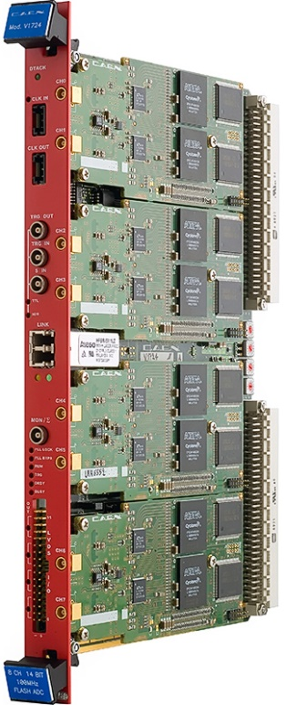
^{n_TOF Data}
α/p/t/γ…
Detector
Source
Voltage
Analog-to-Digital converter (ADC)
in data acquisition (DAQ)
Time
Nikolay Sosnin ²⁶Al Filtering 31 July 2023

Slide 4
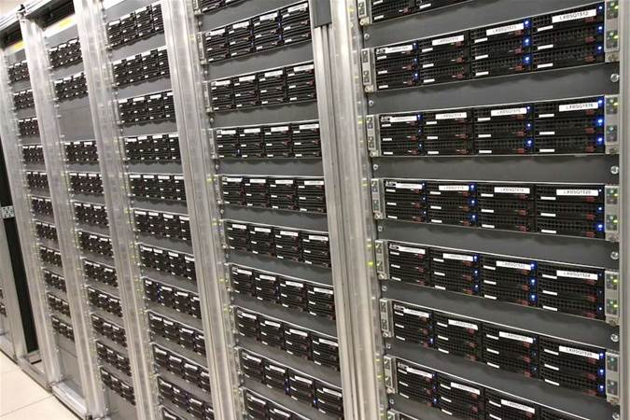
^{n_TOF Data}
α/p/t/γ…
Detector
Analog-to-Digital converter (ADC) cards
in data acquisition (DAQ)
computers
Source
Voltage
Time
CERN tape server
Nikolay Sosnin ²⁶Al Filtering 31 July 2023

Slide 5
^{n_TOF Data}
Pick-up detector senses current induced in beamline by protons and sends signal to DAQ that protons arrive imminently.
DAQ starts saving output of detectors for 120 milliseconds
Trigger to write data
Pick-up (PKUP)
Protons
Lead
Nikolay Sosnin ²⁶Al Filtering 31 July 2023

Slide 6
^{n_TOF Data}
Pick-up detector senses current induced in beamline by protons and sends signal to DAQ that protons arrive imminently.
DAQ starts saving output of detectors for 120 milliseconds
Trigger to write data
Detectors
in EAR2
Neutrons
Pick-up (PKUP)
Detectors
in EAR1
Protons
Lead
Nikolay Sosnin ²⁶Al Filtering 31 July 2023

Slide 7
^{n_TOF Data}
Pick-up detector senses current induced in beamline by protons and sends signal to DAQ that protons arrive imminently.
DAQ starts saving output of detectors for 120 milliseconds
ADC has a certain range (e.g. 14-bit, i.e. 2¹⁴ = 16384 channels into which signal amplitude is divided)
ADC has a certain rate (e.g. 125 mega-samples/second, i.e. signal is written 125e6 times per second = 8 ns / sample)
Signals
Trigger to write data
Detectors
in EAR2
Neutrons
Pick-up (PKUP)
Detectors
in EAR1
Protons
Lead
Nikolay Sosnin ²⁶Al Filtering 31 July 2023

Slide 8
^{Staging}
Data saved on tape server can be re-accessed through two steps:
Staging: converting magnetic tape back to digital data (takes a few days) stored on computer cluster LXPLUS
raw2root: C++ based code, which converts digital output of tape server to ROOT histograms for analysis
Voltage
Staging + raw2root
Time
CERN tape server
Nikolay Sosnin ²⁶Al Filtering 31 July 2023

Slide 9
^{raw2root}
raw2root is composed of two main components
ntoflib, custom n_TOF analysis libraries
detector class, user-written routine
In detector class, user specifies how the signal trace should be handled (filtering) and what parameters are saved to raw2root output
UserInput
ntoflib
Detector
class
raw2root
Desired output, e.g. amplitudes, times of signals
Nikolay Sosnin ²⁶Al Filtering 31 July 2023

Slide 10
^{MWD detector class}
Edinburgh group have a custom detector class for raw2root, called MWDdetector.cc
The code applies a series of digital filters to data to efficiently extract signal times and amplitudes
Filters:
Moving Average
Single-pole low- and high-pass filters
Differentiator
Moving Window Deconvolution (MWD)
Digital filtering compendium:
http://www.dspguide.com/pdfbook.htm
Nikolay Sosnin ²⁶Al Filtering 31 July 2023

Slide 11
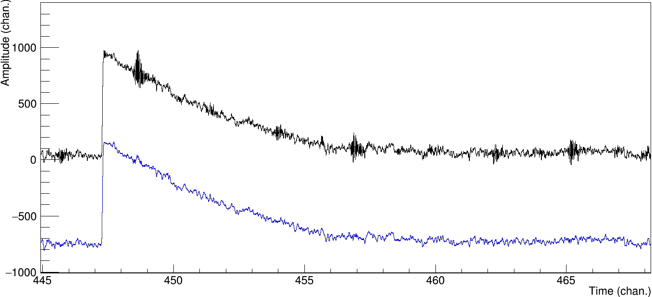
^{Moving Average (MA)}
A window of fixed width moves through signal trace time channel by time channel.
Averages all the data points within a window
Results in a smoother pulse with less high-frequency noise, which gets averaged out between channels
Window size is best set to noise risetime in channels as a first guess (careful that it's not the identical to signal risetime, or things get tough)
Pulses offset vertically for visibility
Original
After moving average
Nikolay Sosnin ²⁶Al Filtering 31 July 2023

Slide 12
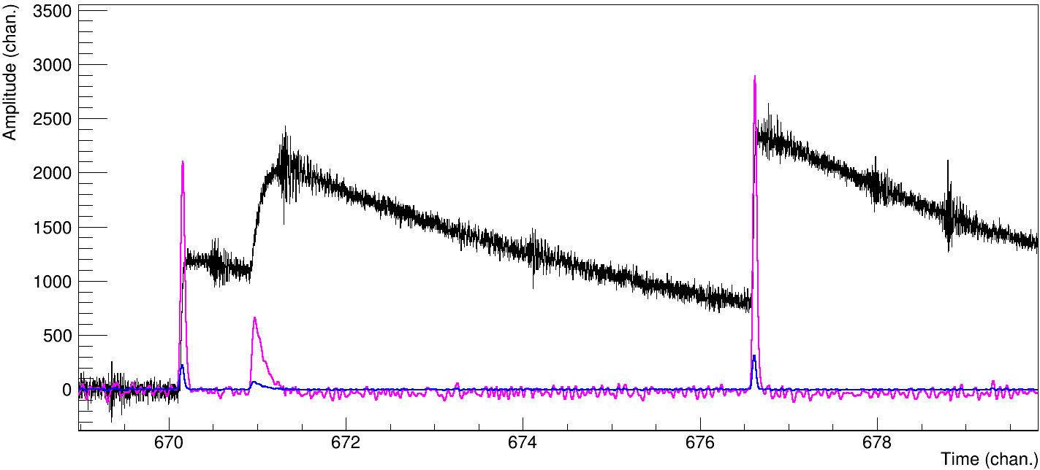
^{Low- and high-pass filters}
Digital filters have transfer functions, which define filter response to inputs at a given signal frequency (think Fourier analysis, converting amplitudes to frequencies of waves added to put together a given signal shape)
Poles and zeroes of a transfer function define which frequencies get amplified and which zeroed
Low- and high-pass filters define an upper and a lower boundary on frequencies that are transferred to filter output
Can cut out specific noise (e.g. 50-60 Hz oscillations from poor grounding, MHz oscillations from unshielded cable) as a result
Original
After low-pass
After high-pass
Nikolay Sosnin ²⁶Al Filtering 31 July 2023

Slide 13
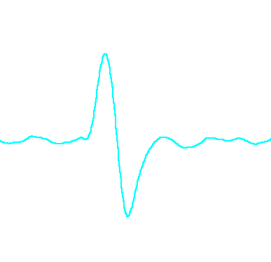
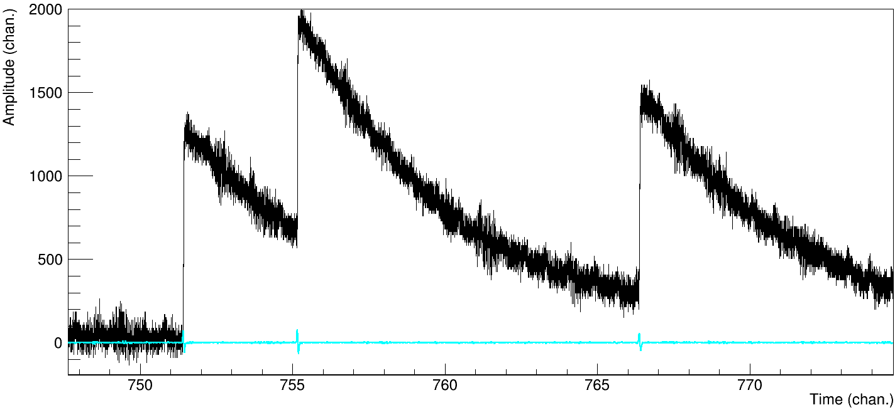
^{Differentiator}
Takes the slope over a certain dT window of the high- and low-pass filtered trace
When derivative passes over a real signal, it will increase above baseline, then drop below baseline
Zero-crossing identifies signal time
This corresponds to a consistent fraction of signal amplitude for a properly-chosen window size
First-guess window size = signal risetime
Zoom
Original
Derivative
Nikolay Sosnin ²⁶Al Filtering 31 July 2023

Slide 14
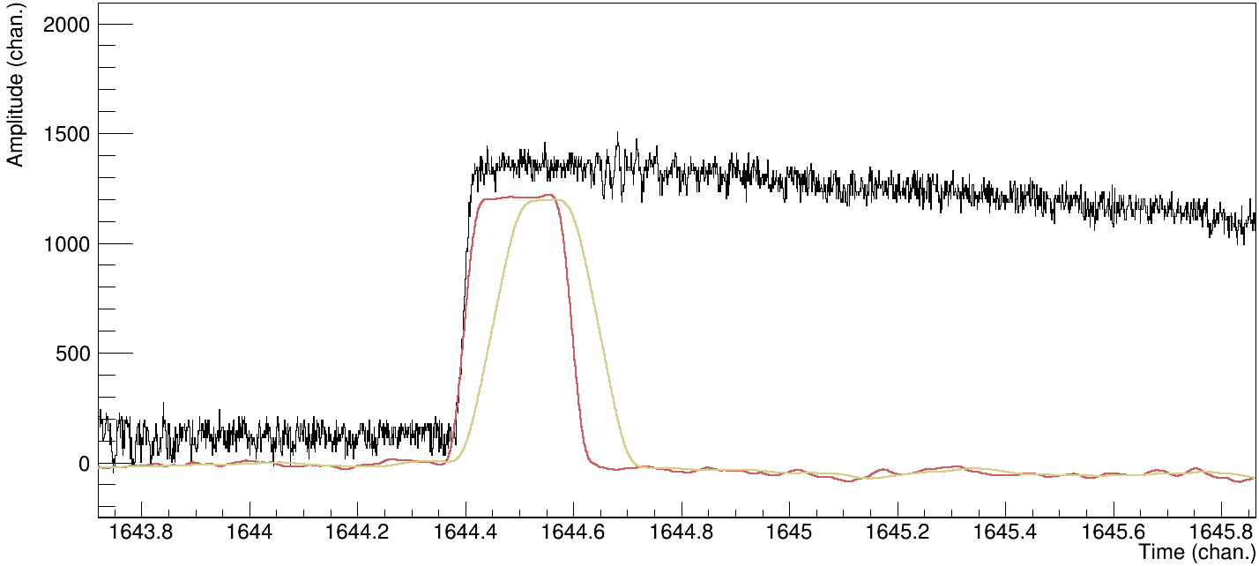
^{Moving Window Deconvolution}
Jordanov and Knoll, NIM A 345 (1994), 337-345 (not original paper, but best explanation)
Compensates for ballistic deficit (loss of signal during pre-amp charge collection time due to pre-amp continuously discharging as signal is collected)
Several parameters: timing constant μ (the decay time of pre-amp provided by manufacturer), windows m and l (m = moving window size, should be at least equal to full risetime of a signal, l = flat-top width)
Produces trapezoidal output (so if flat-top width = 0, the output is a triangle)
Allows clean amplitude extraction
If μ is set incorrectly, the pulse does not return to baseline (under- or over-shoot)
Original
MWD
MWD+MA
Nikolay Sosnin ²⁶Al Filtering 31 July 2023

Slide 15
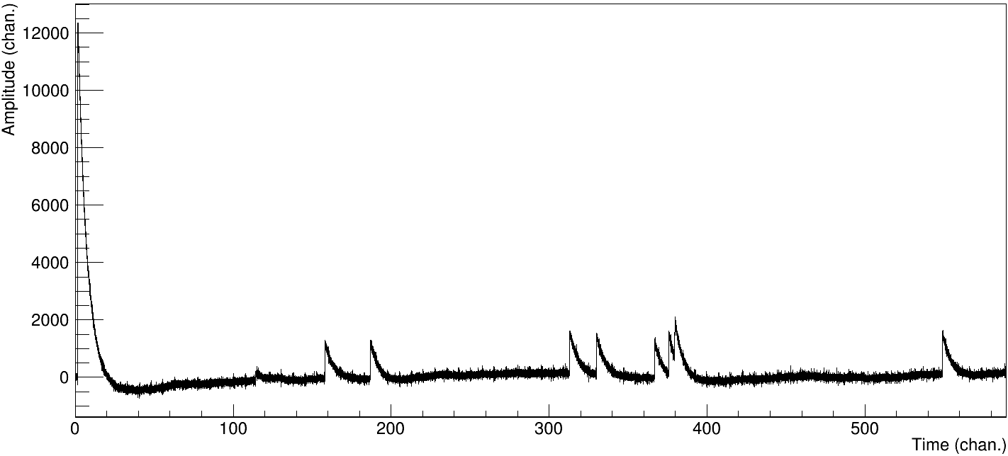
Baseline estimation (not a filter, but important at n_TOF)
After gamma-flash, there can be long undershoot in baseline
MWDdetector class uses three segments of baseline before a signal candidate, averaging the signal there
Lowest of the three is chosen as "true" baseline
Nikolay Sosnin ²⁶Al Filtering 31 July 2023

Slide 16
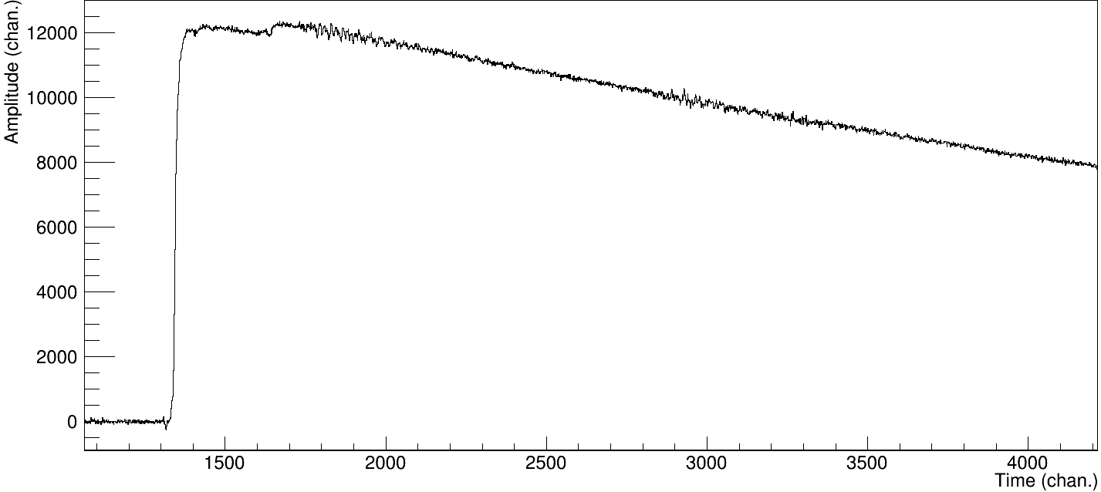
^{Summary}
raw trace
Mission: get signals here
2x MA
Pulser
high-pass
MWD
The dreadful gamma flash
low-pass
MA
Differentiator
Baseline
Signal time
Amplitude
Nikolay Sosnin ²⁶Al Filtering 31 July 2023

